Slide 1
Mindspeak App
By Micheal Abera and Keshav Mohan

Slide 2
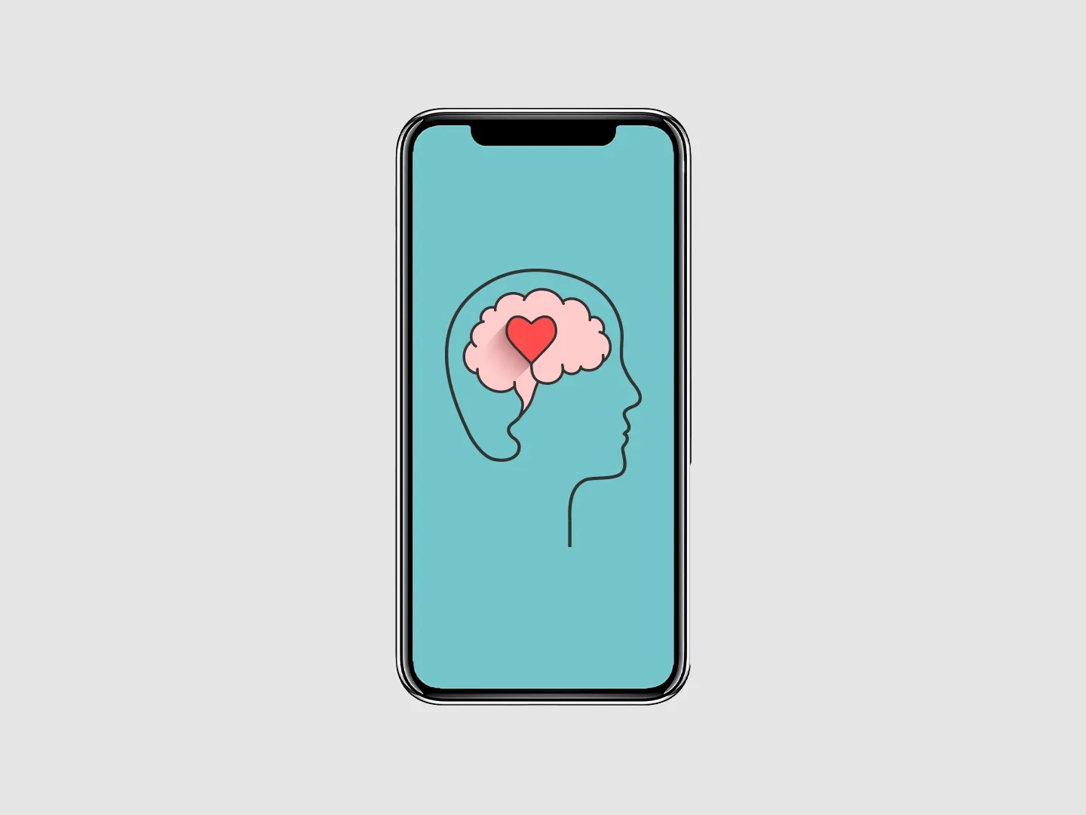
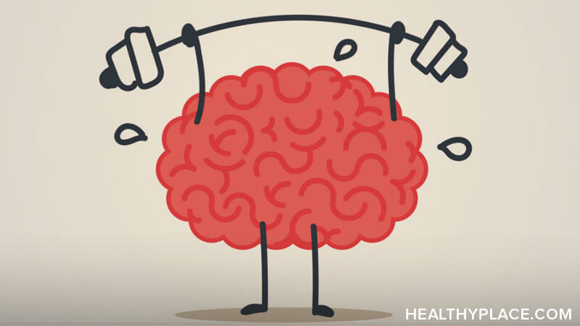
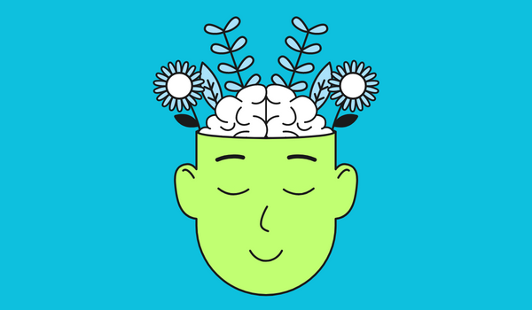
What is this app about?
-Its an app designed to help you speak more naturally and professionally less like a robot and more like yourself.
-MindSpeak aims for a 5-star user rating by reducing stress and anxiety through features like guided meditation and breathing exercises.
-These tools promote a calm state of mind, making the app an essential companion for anyone looking to enhance their communication skills.
-The more users engage with MindSpeak, the more their confidence and speaking abilities improve, fostering a safe and healthy environment that supports better mental health overall.

Slide 3
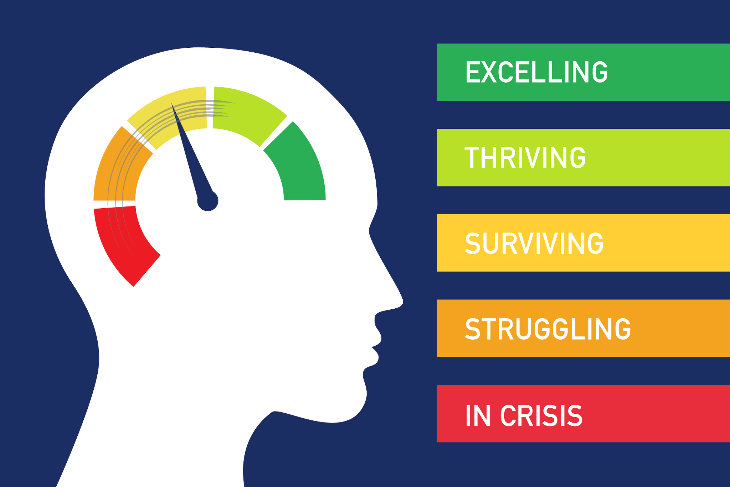
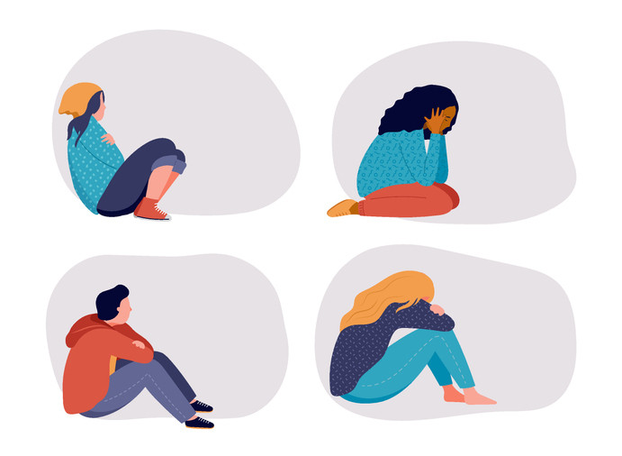
What is the problem that we are trying to fix?
-These days, people’s confidence skills are severely going down due to the rise of social media
-That's why we are trying to make a change, to help people to get out of their comfort zone, and start making friendships, start looking more confident and sound more confident with our project.
- Humans are animals, animals are designed to socially interact with each other, humans are designed to go outside and interact with one another, not staying at home and scrolling through social media for 8 hours each day.

Slide 4

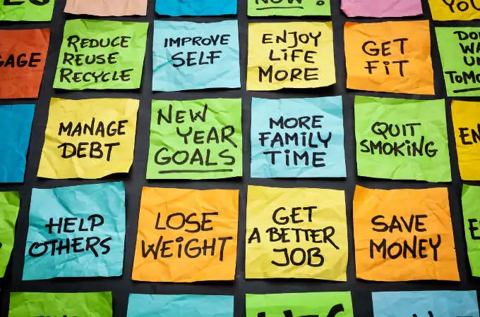
Goals for the project:
Goals for the project include:
-Helping people to feel better about themselves
-Making sure that user has a five star experience on the app
-Helping the user to get out of their comfort zone

Slide 5
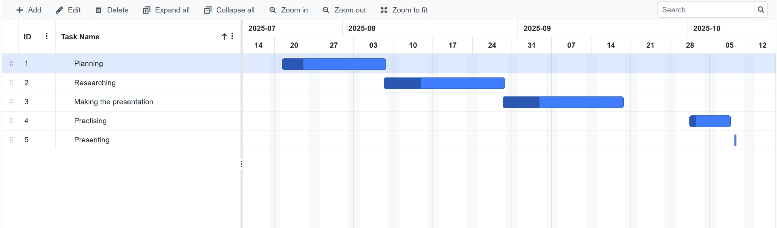
Gantt Chart:

Slide 6


Target audience:
MindSpeak target audience includes individuals pursuing careers where strong communication is essential such as CEOs, presenters, and content creators as well as anyone looking to build confidence in their speaking skills. It’s especially helpful for shy or reserved people who want to express themselves more clearly and confidently. It's designed to get people out of their homes and get out of their comfort zone, to help them feel more comfortable speaking with a random stranger.

Slide 7
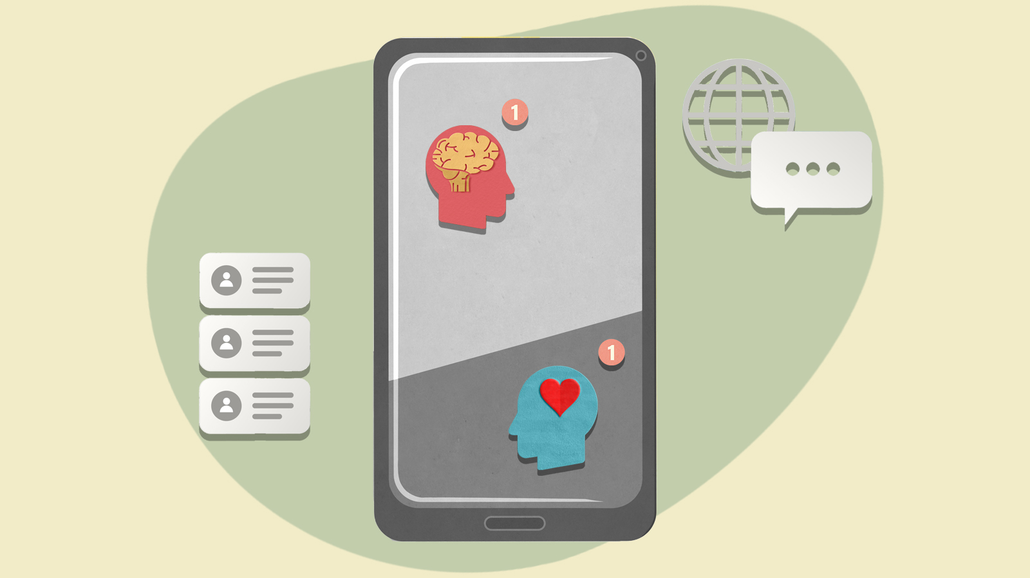
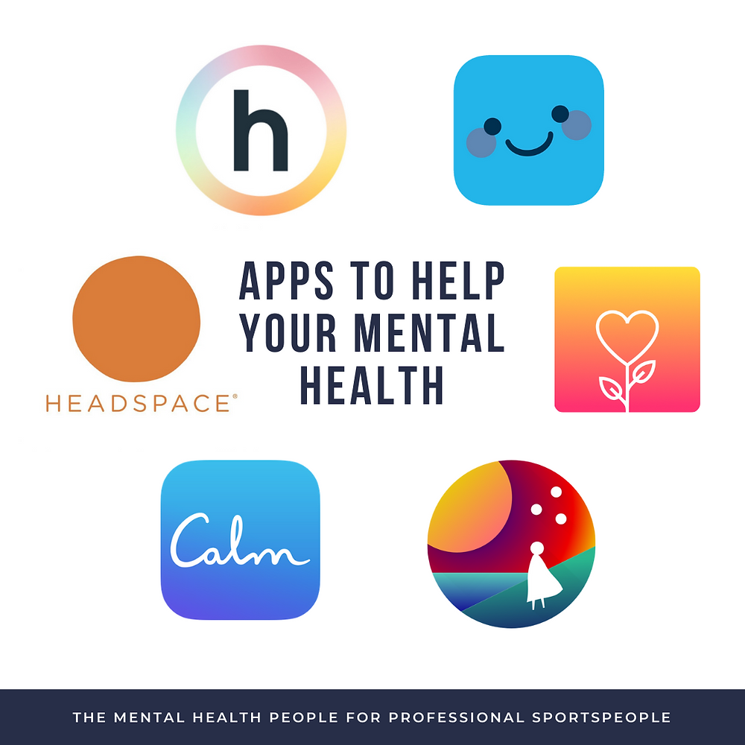
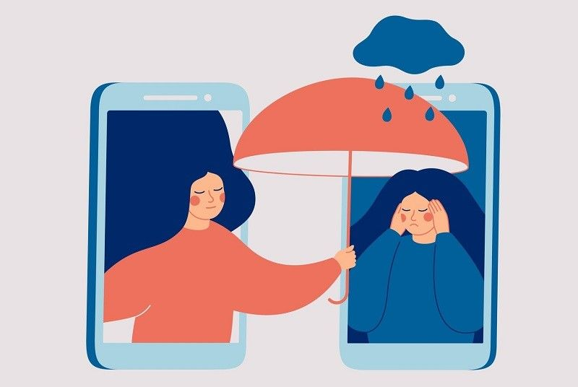
The solution requirements:
-The app must help the user improve in their speaking abilities through guided exercises and positive feedback
-The app must be safe to the user with medically reviewed content and protecting personal data of their account
-The app must be able to let the user learn something new about communication everyday just to improve their confidence

Slide 8
Functional Requirements:
-The app should deliver notifications to encourage the user to stay on the app
-The user should be able to report bug and give the developers feedback
-The app should allow the user to customise their notification settings

Slide 9
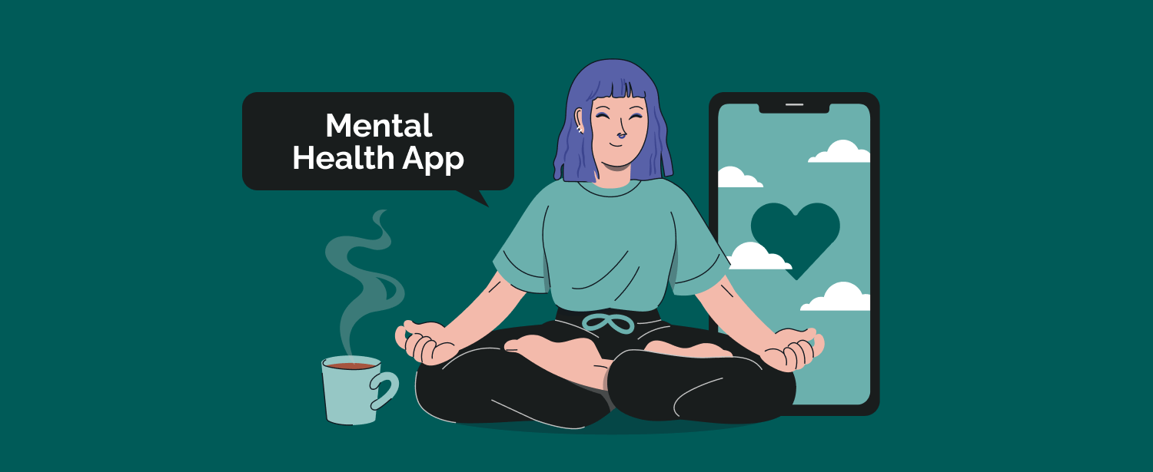
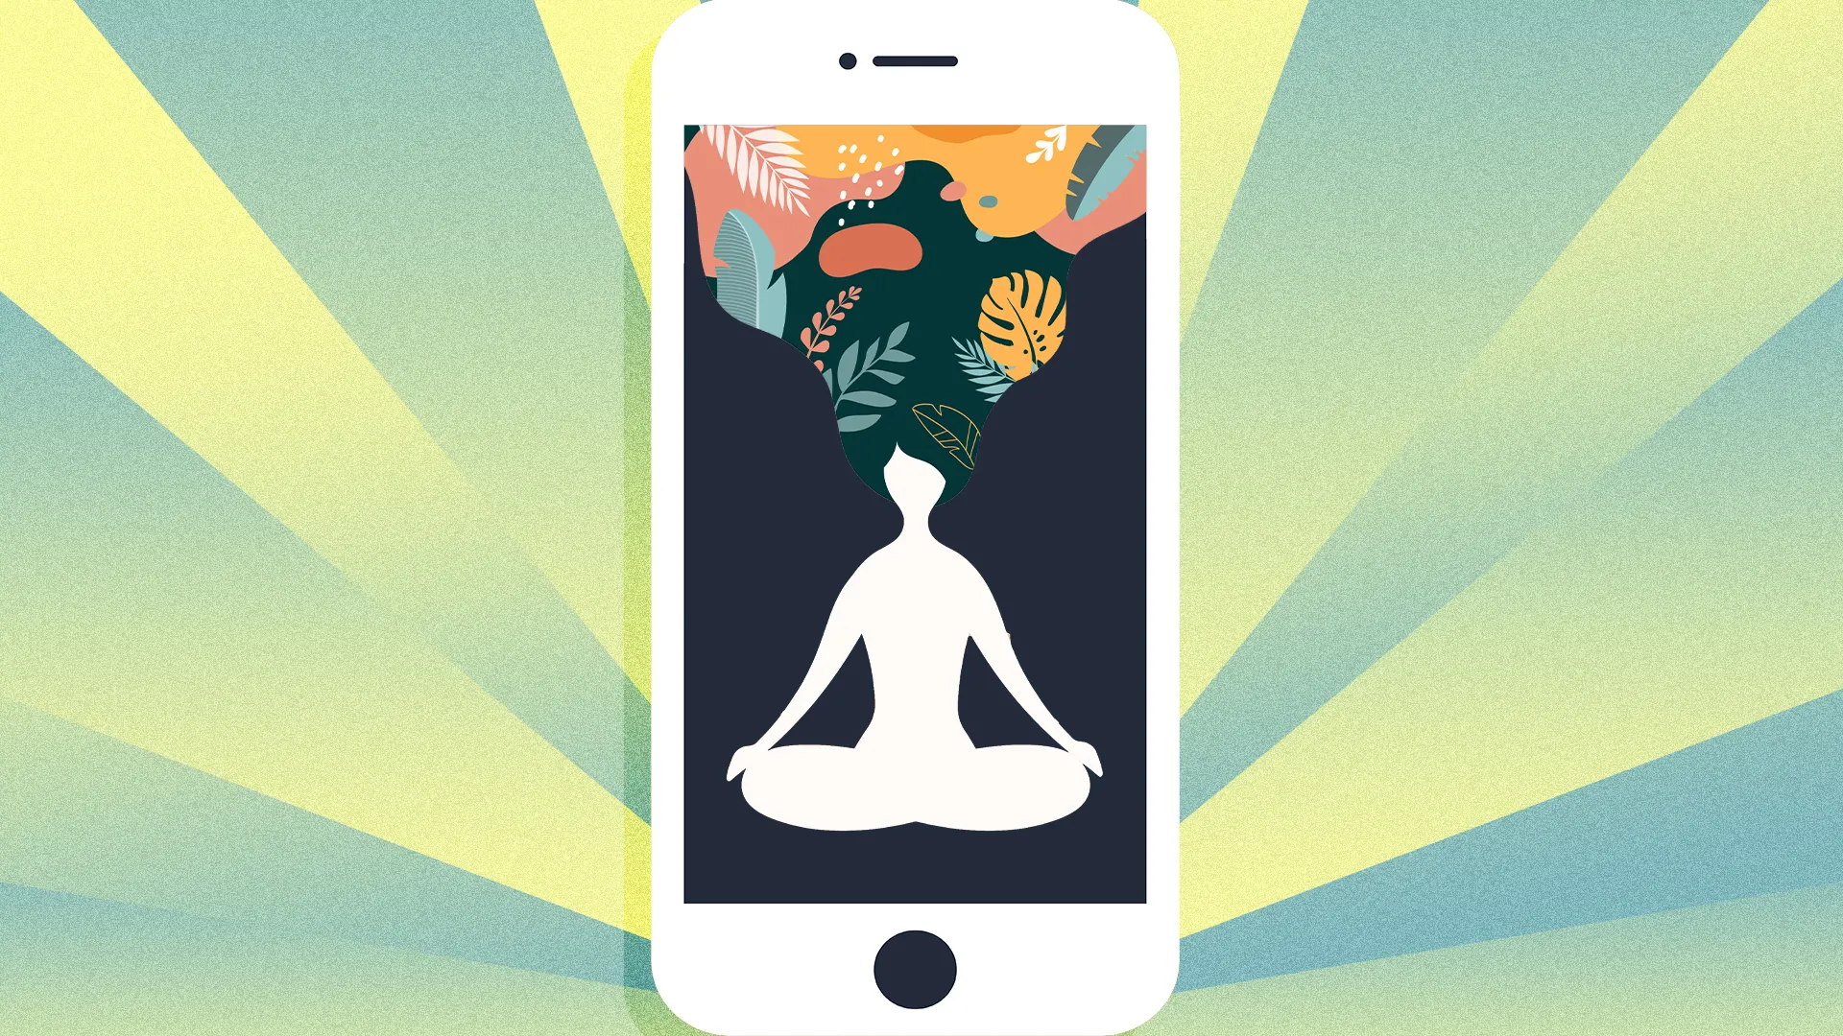
Non functional requirement:
-The app must have not have any bugs so that the user can have a smooth experience
-The app should have strong and secure data storage to protect the user data and personal health information
-The app will include expanding features,platform compatibility and encourage honest self-reflection

Slide 10
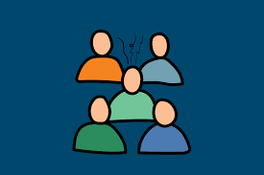

Constraints
-This app will try and help you but won't guarantee anything
-Users might short attention spans so longer sessions might make them quit
-There might be language barriers as users mind not be able speak English and this app is only in English

Slide 11

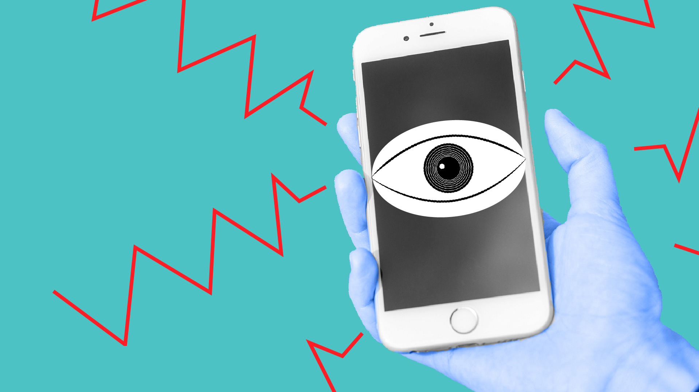
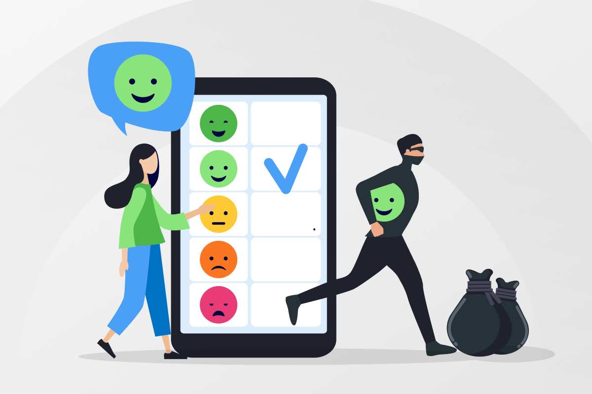
Privacy act
-The mental wellbeing app must observe with the Privacy Act 1988 and the Australian Privacy Principles in which it helps govern the personal information of individuals
-The app needs to have a transparent privacy policy with mental health information just to make certain of the user’s content

Slide 12
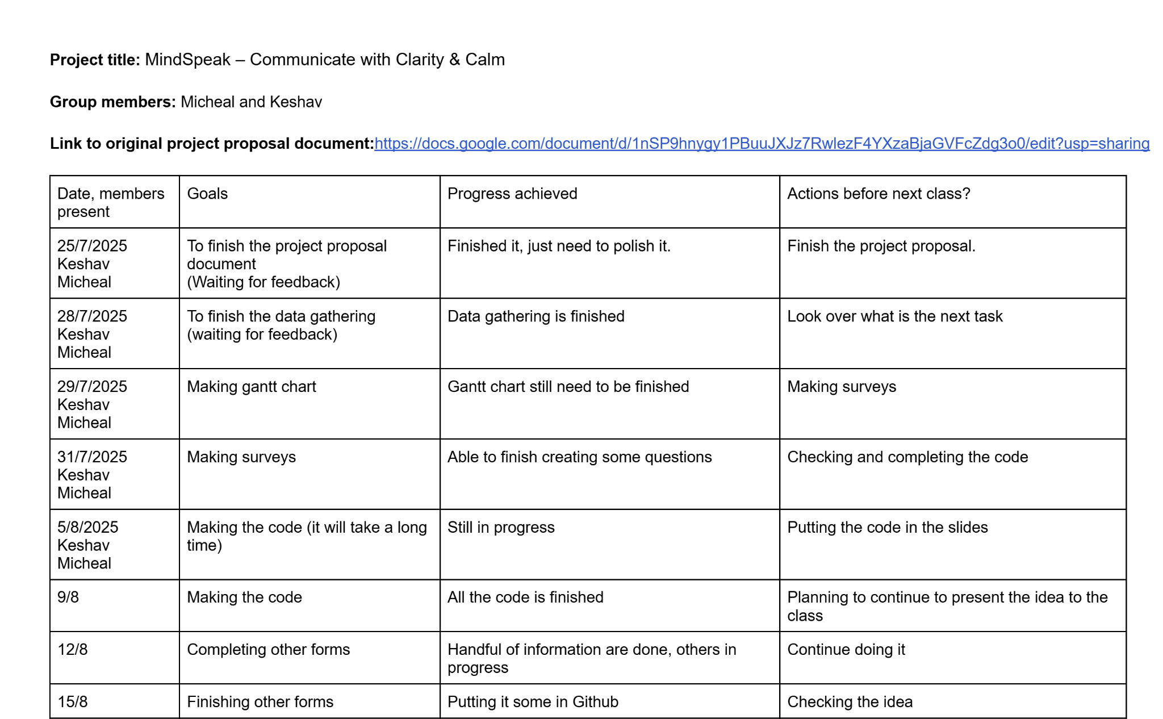
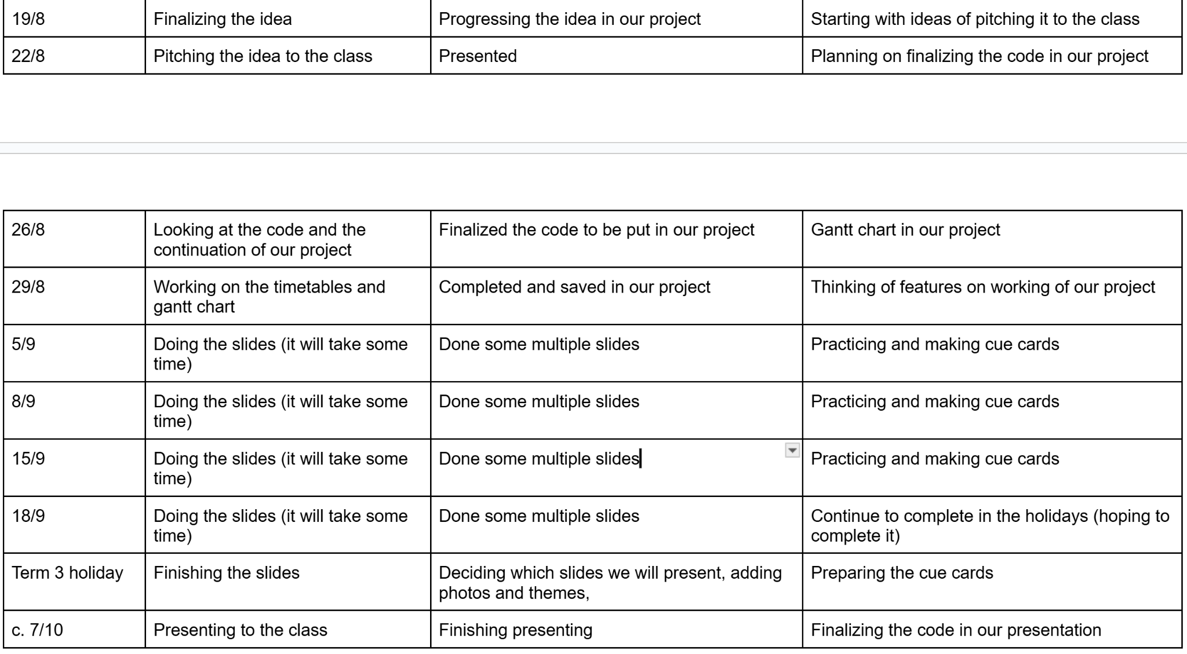
Group minutes:

Slide 13
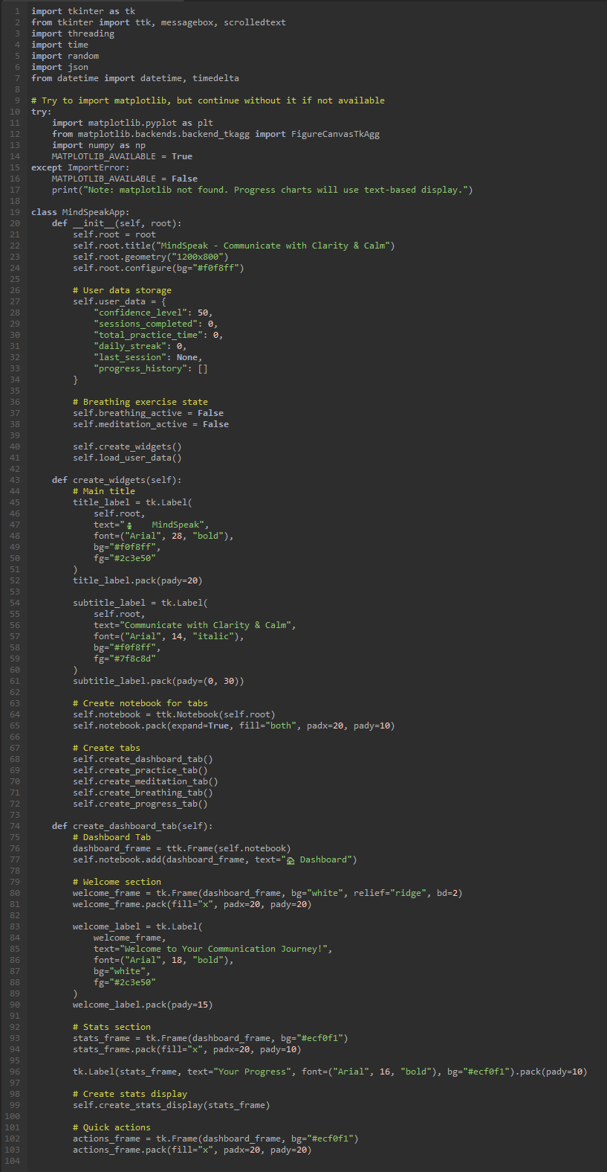
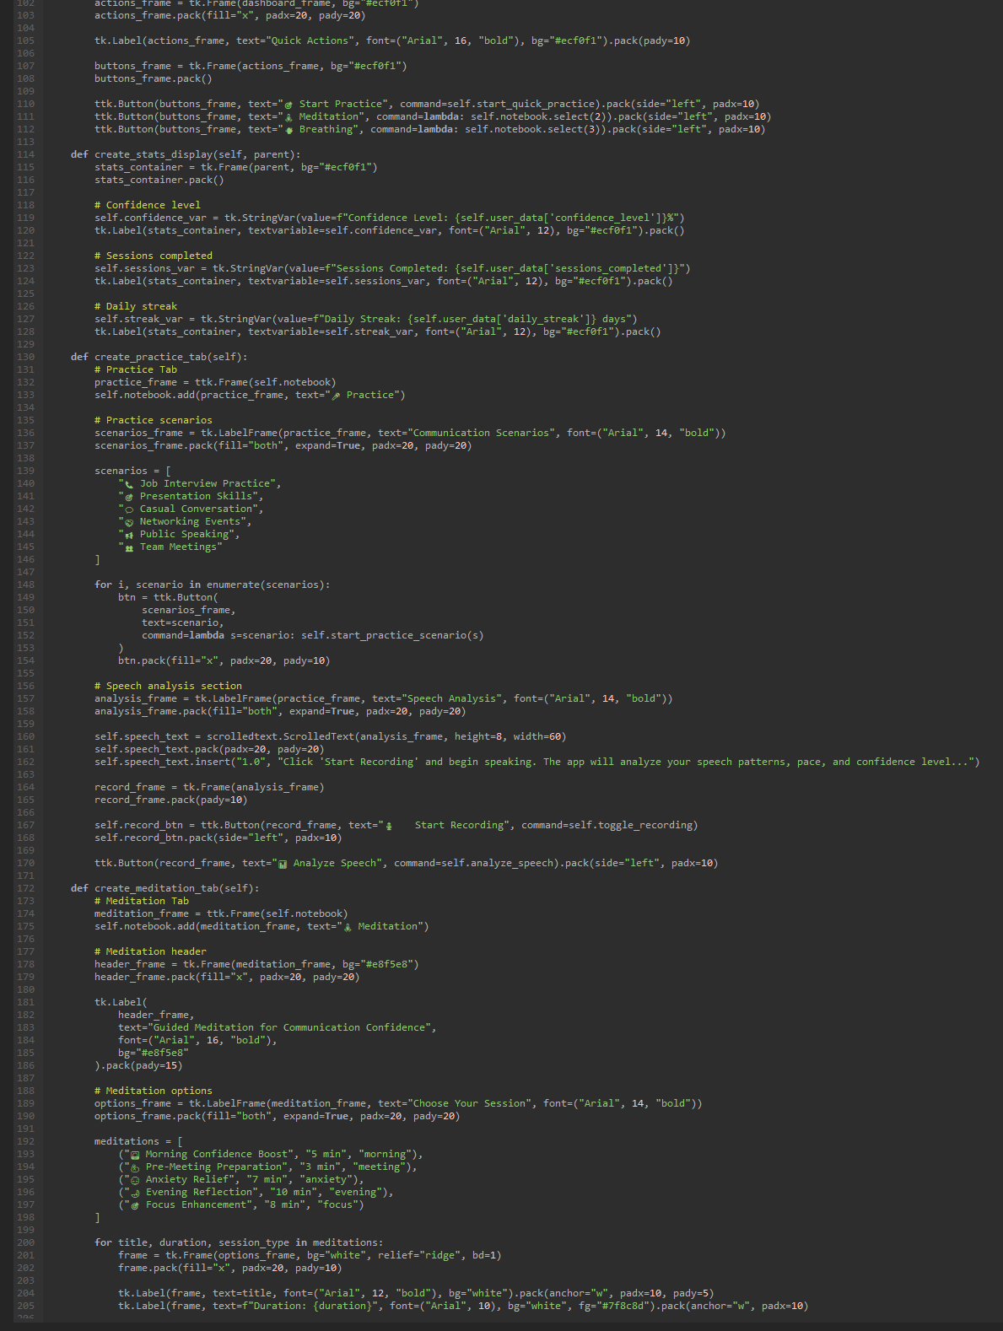
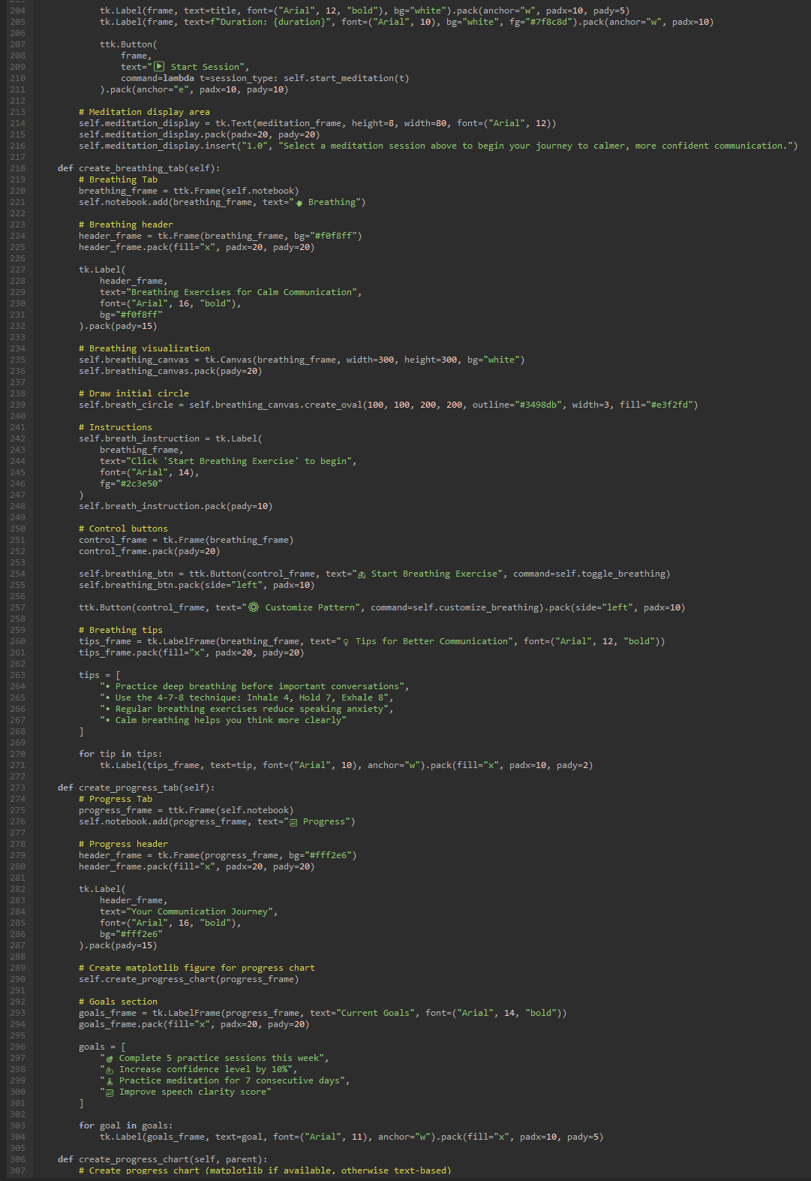
Code for the app (not the final product)

Slide 14
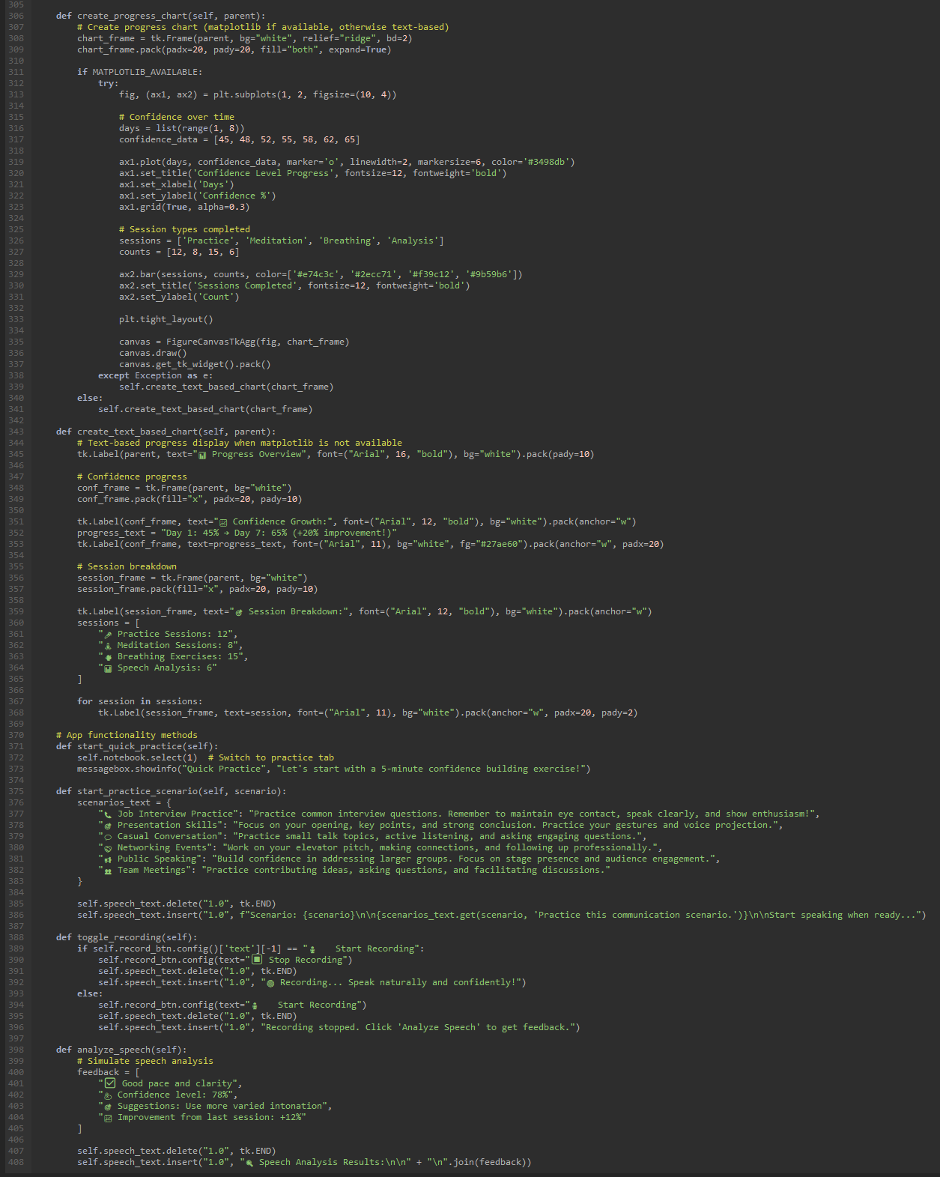
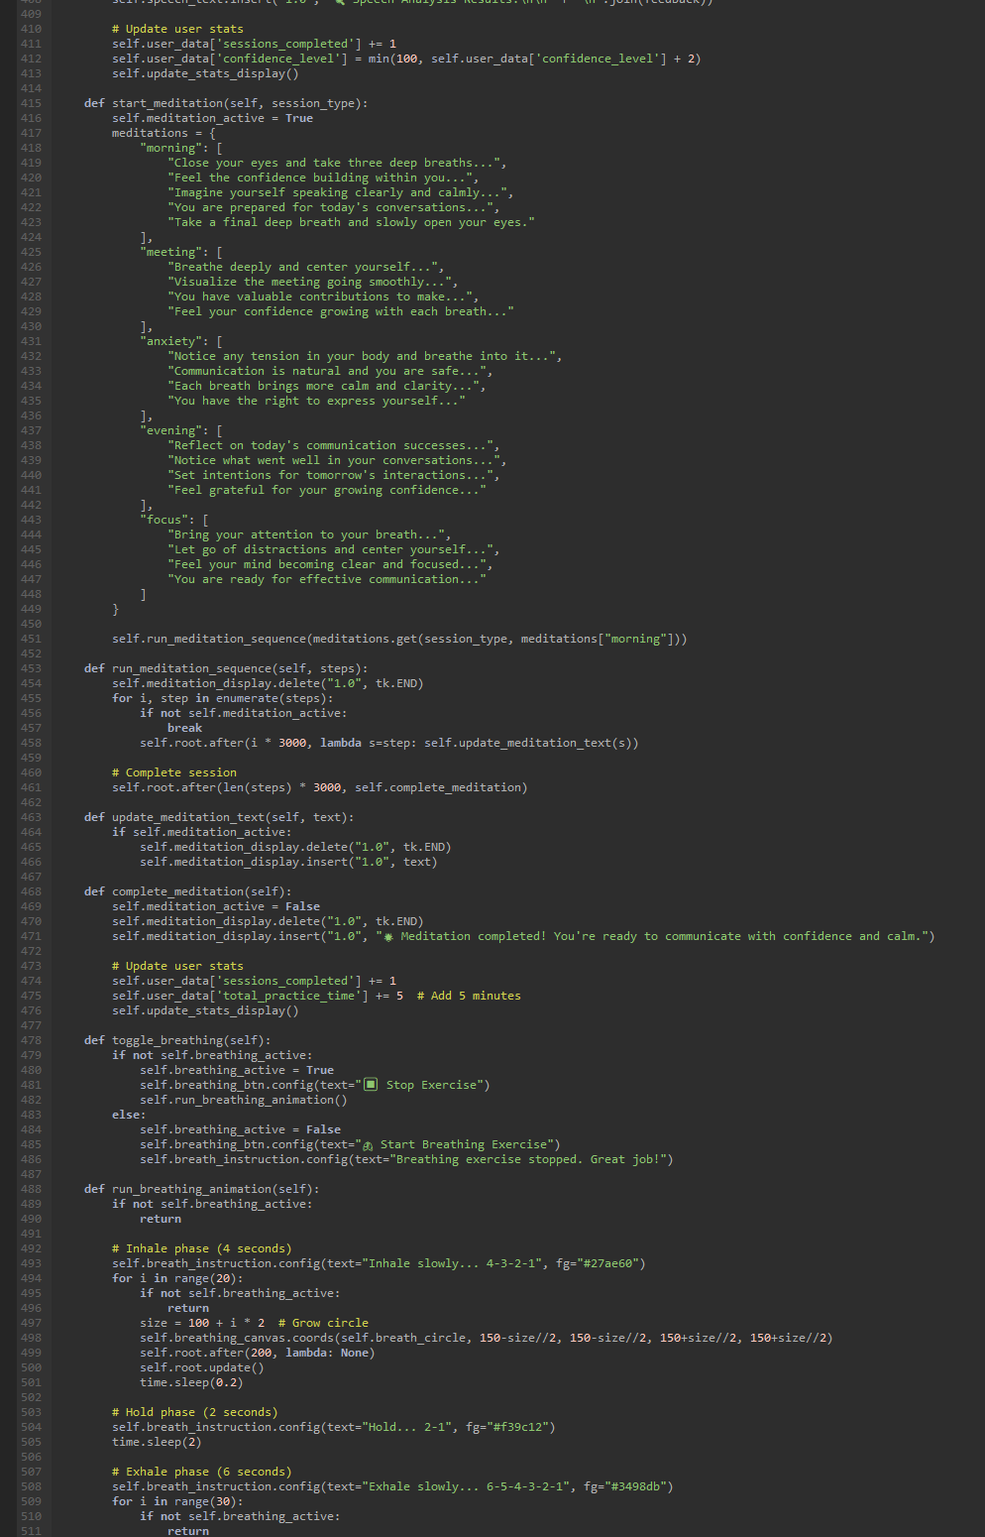
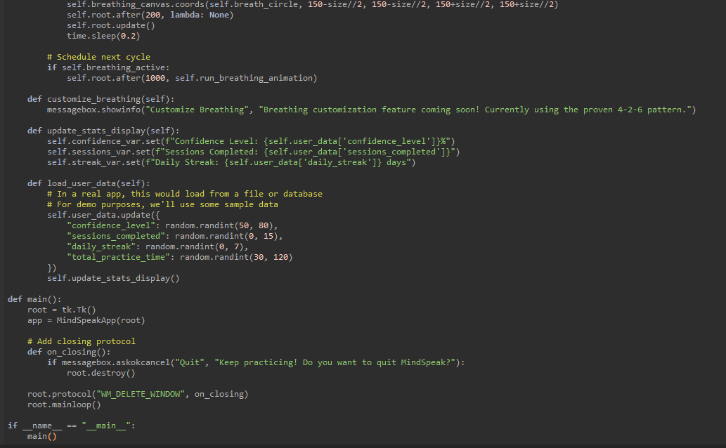
The continuation of the code:

Slide 15
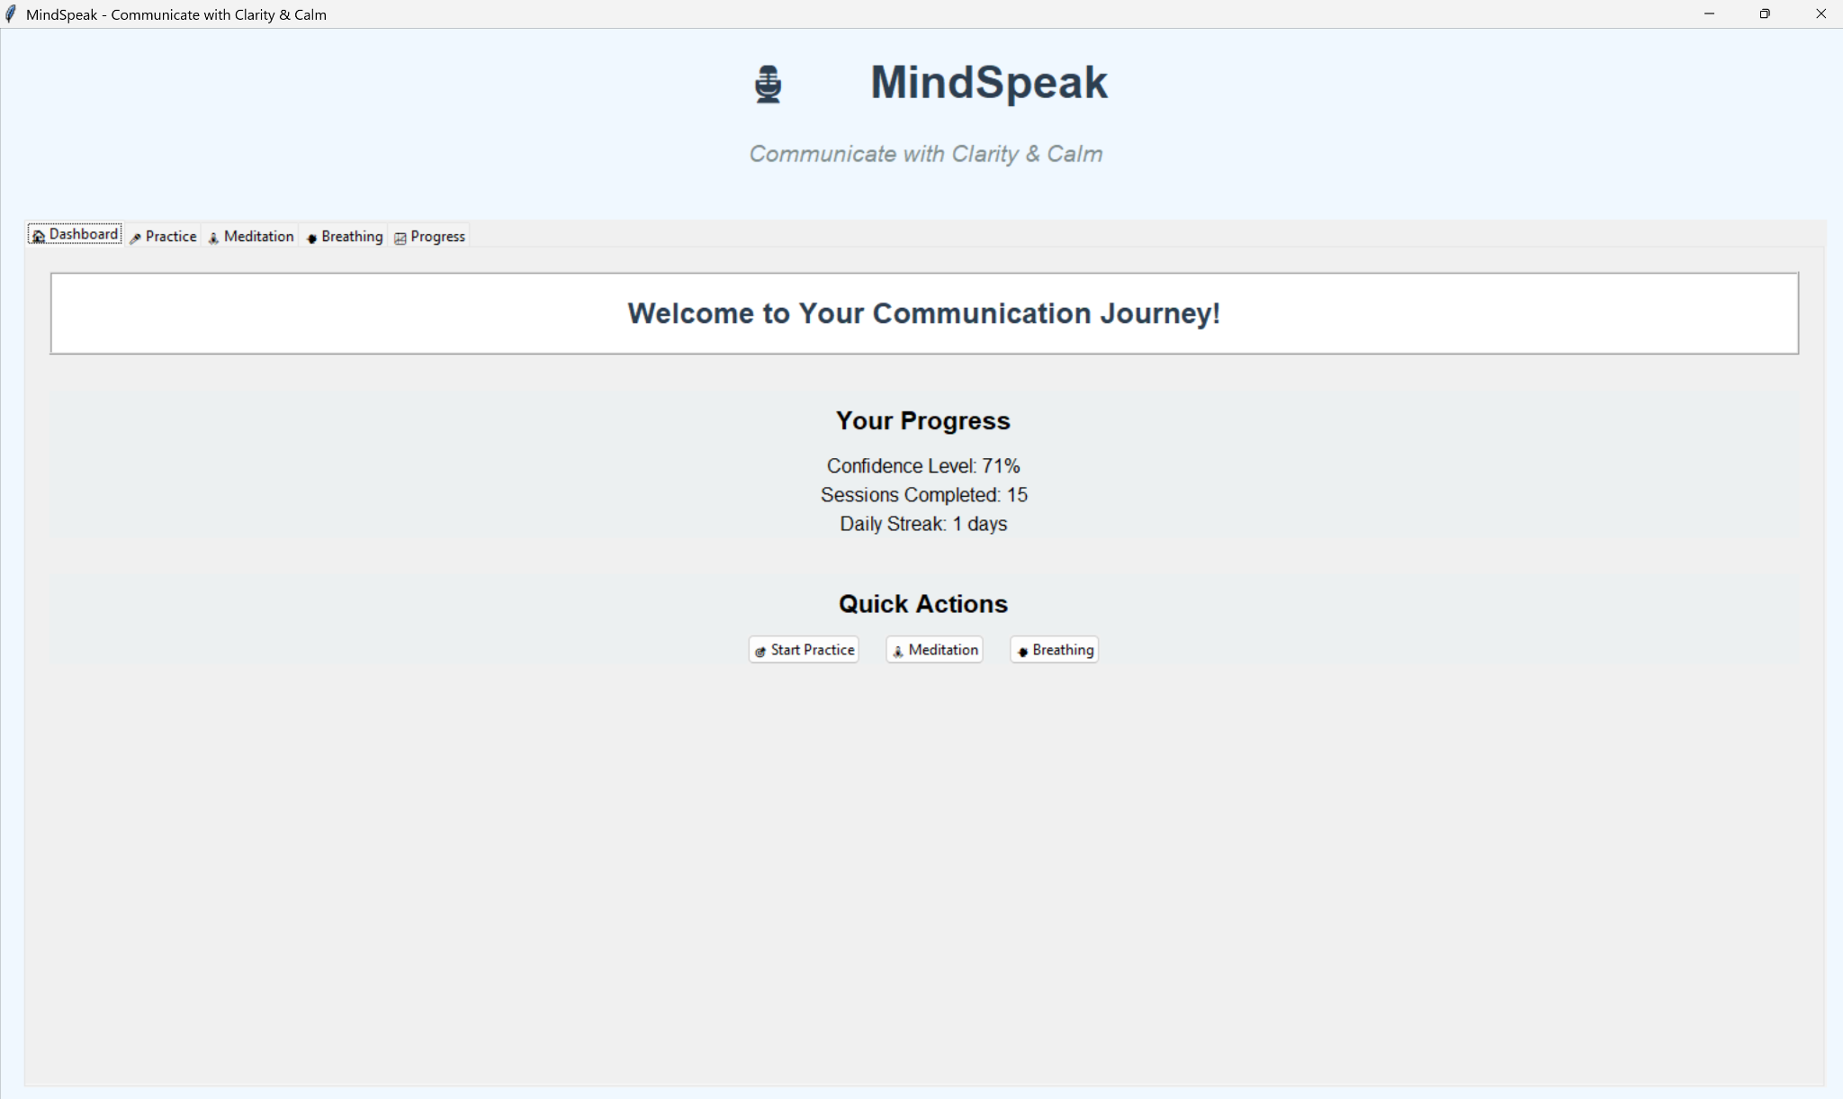
How would the app look like if there was code:

Slide 16
Sample of the Psuedocode:
MAIN PROGRAM:
FUNCTION main():
CREATE main window
CREATE instance of MindSpeakApp(root)
DEFINE on_closing():
IF user confirms quit:
CLOSE window
SET close protocol to on_closing
START main loop
CLASS MindSpeakApp:
FUNCTION __init__(root):
SET window title, size, background
INITIALIZE user_data:
confidence_level = 50
sessions_completed = 0
total_practice_time = 0
daily_streak = 0
last_session = None
progress_history = []
SET breathing_active = False
SET meditation_active = False
CALL create_widgets()
CALL load_user_data()
We used the help of Ai for this

Slide 17
Evaluation table (alternative ideas)
Alternative ideas for the project
Idea | Innovation (20 points): How unique and innovative is the idea? | Feasibility (20 points): Can the idea be realistically implemented given time and resources? | Impact (20 points): How significant is the problem or opportunity the idea addresses? | Relevance (20 points): How well does the idea align with the specified topics (AI, IoT, etc.)? | Differentiation (20 points): How does the idea improve upon existing solutions?
MindSpeak – Communicate with Clarity & Calm, An app that helps you communicate | 14/20 This idea of an app is already there like Orai, speeko and poised. | 17/20 The idea can focus on these feasibility that includes Ai-generated,GPS,motion and background audio. | 18/20 The impact of the idea is to help reduce stress,depression and anxiety as well as promoting healthy habits for the daily routine to improve the person’s mental and physical well-being. | 17/20 The idea is clearly relevant because the plan is to fix problems such as technology stress,busy lifestyle and plan to provide stress relief for everyone/ | 16/20 This idea is to improve with this existing solution to help the people focus quietly and practise with their mindfulness.
Support Circle An app that helps with your mental health. | 10/20, There are plenty of apps like this for example headspace, calm and Moodfit | 19/20 The idea plans to have a time-balanced routine for mental health including how many minutes of meditating,foods for the day,etc. | 17/20 The impact of SupportCircle can help people’s mental health as mental health is the most important thing to take care of. | 18/20 The idea is comparable with other mental health apps in terms of the main topic being focused | 10/20 This app is like any other mental health app
MoodLink An app that tracks your behaviour to alert you before a mental health crisis | 18/20, it's more just a mental health app, more unique than a regular mental health app. | 10/20, if we were going to do this idea, it would take more than a term. | 15/20, this app will be very useful for people who are not in the best of places in terms for their mental health | 16/20, This is app is relevant as we are trying to help people’s mental health and communication | 18/20 The idea of the app should meet the essential requirement targeted at the customers with bad mental health
Mindspeak-82/100
Support Circle-74/100
Moodlink-77/100

Slide 18

Site Map
This is the site map:
https://www.gloomaps.com/Cak7xKJXfX

Slide 19
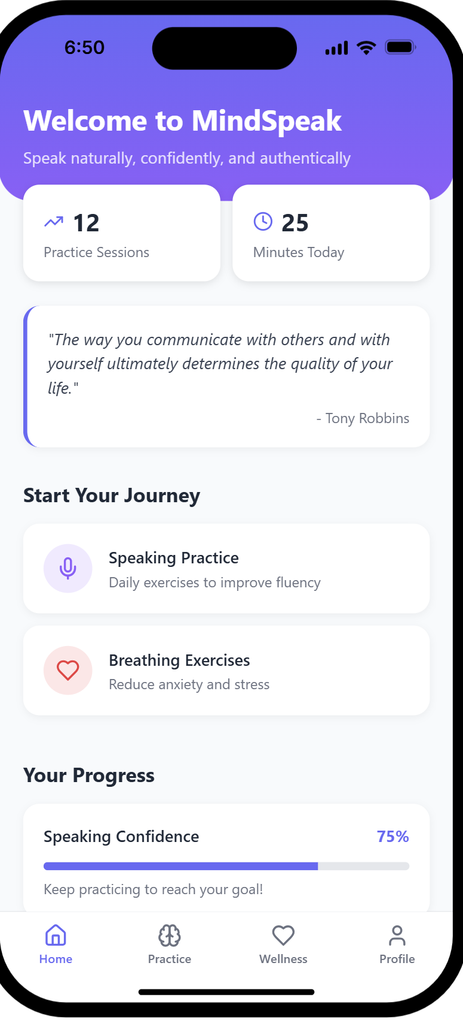
Storyboard:
This is how the app would look like:
This is the dashboard:
This quote sets a very good example for people struggling with mental health
If you click on “Speaking practice” It will open up a new page, giving you different scenarios for example job interviews and gives you different prompts
If you click “Breathing Exercises” and “meditation” It will open up a new page, guiding the wellness activities like body scan,confidence boost and guided meditation

Slide 20
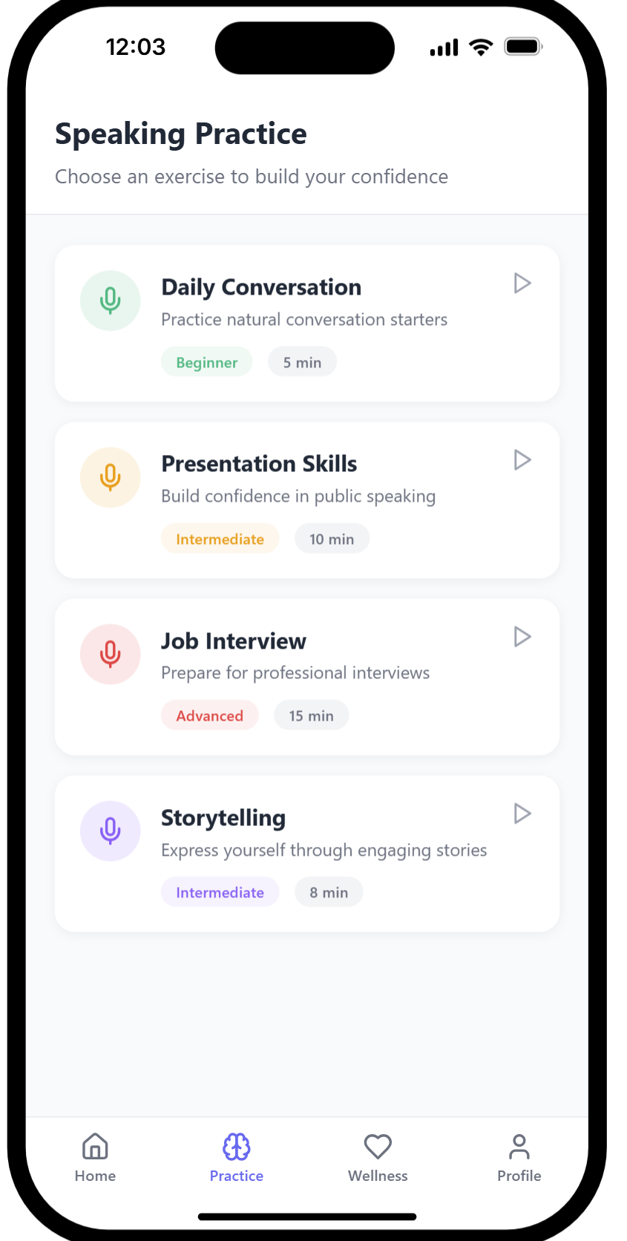
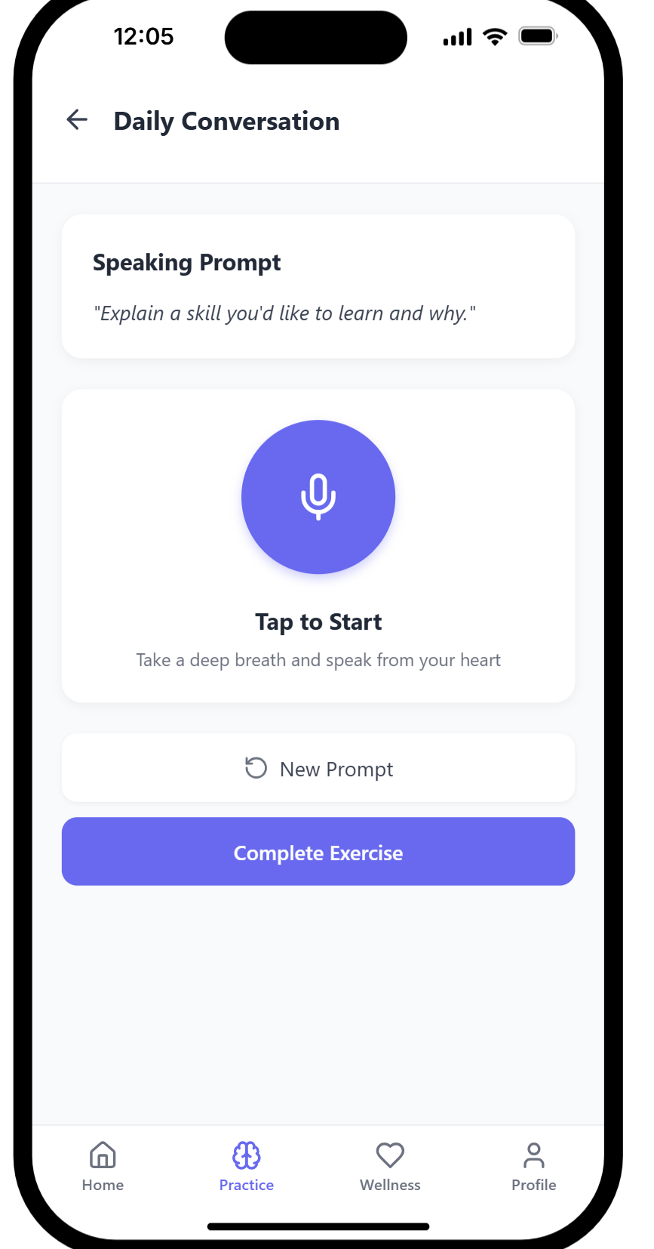
How does different pages works: (speaking practice)
Speaking prompts refreshes after you complete the exercise

Slide 21
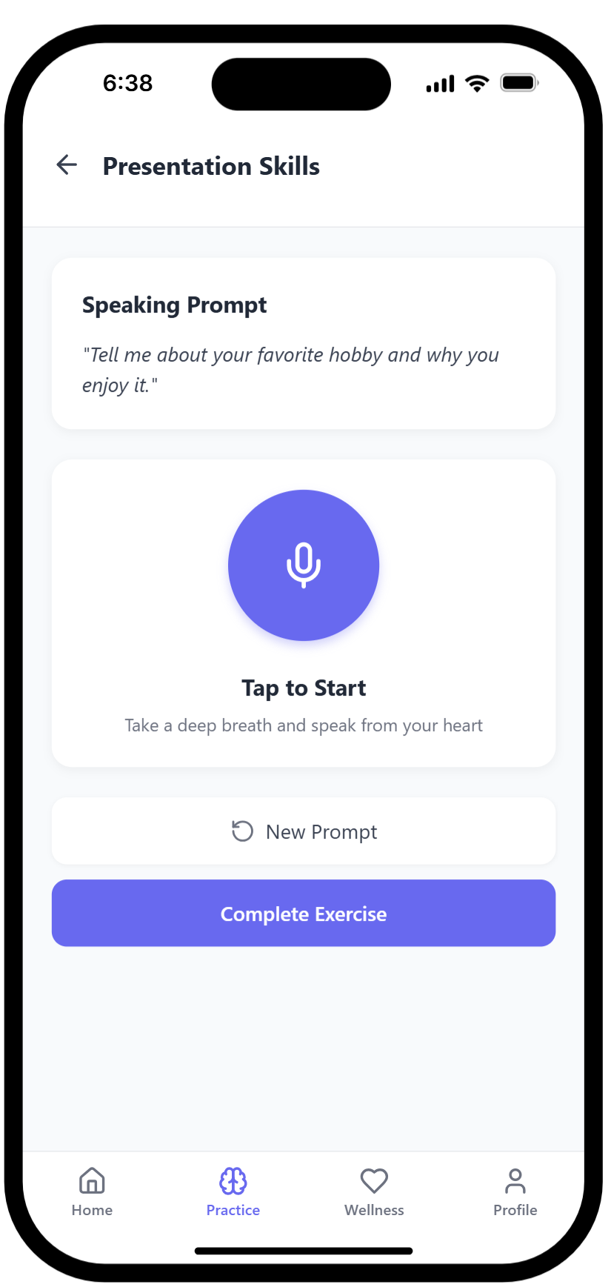
How does different pages works: (speaking practice)

Slide 22
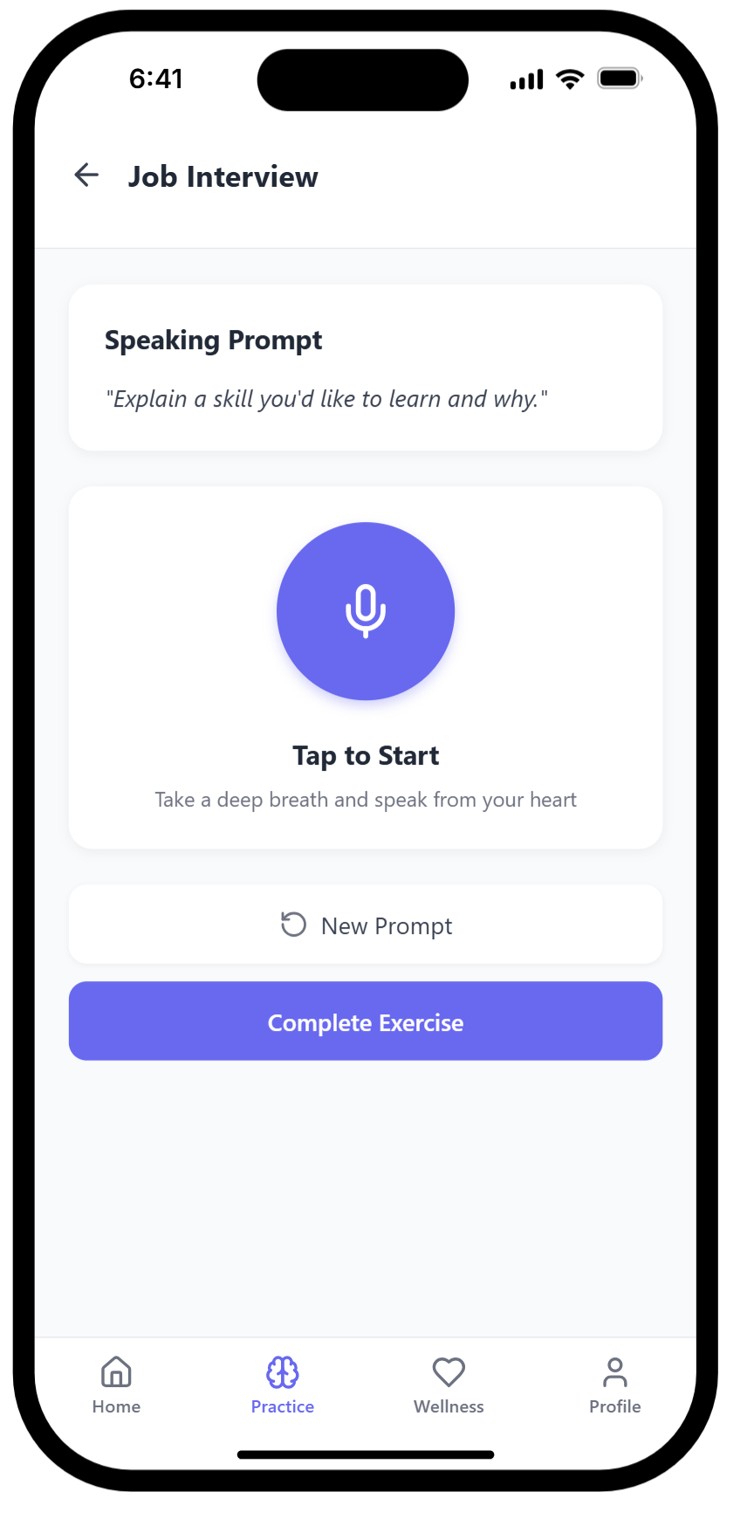
How does different pages works: (speaking practice)

Slide 23
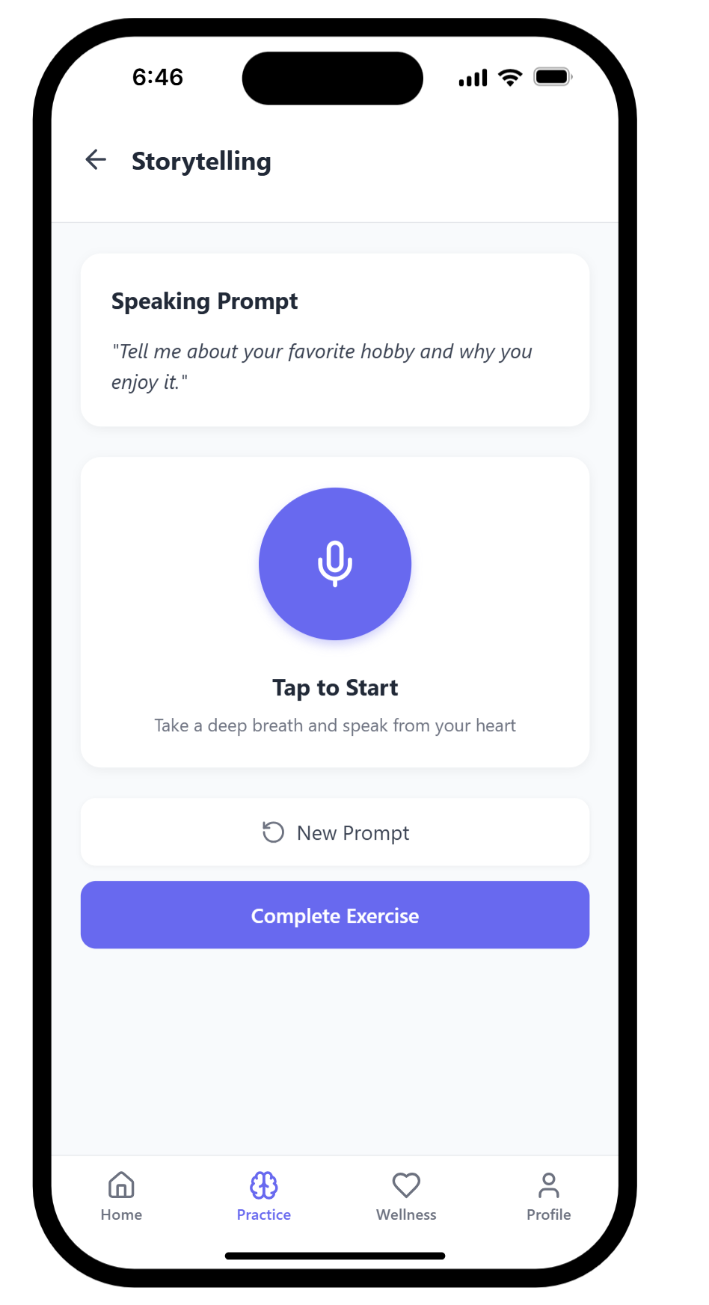
How does different pages works: (speaking practice)

Slide 24
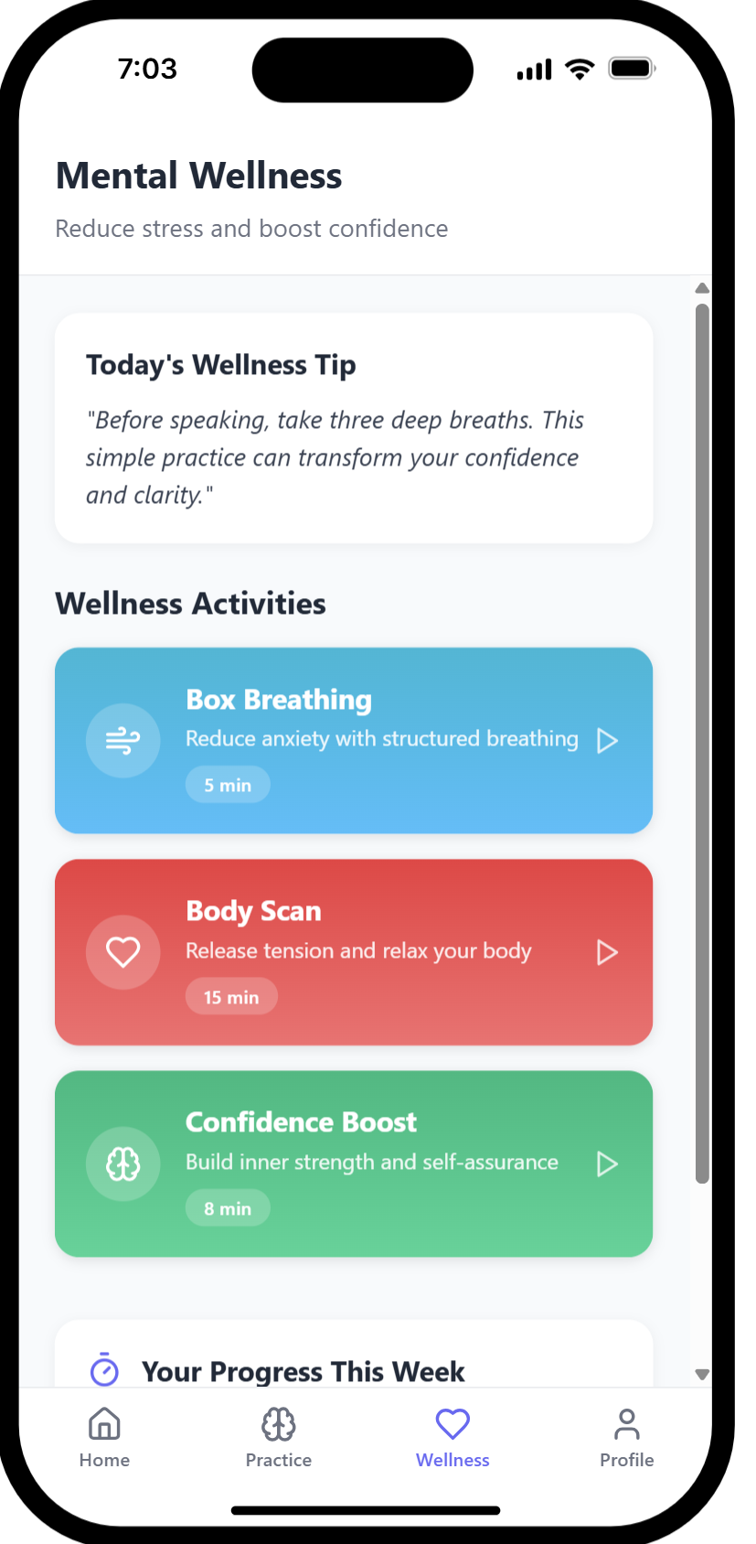
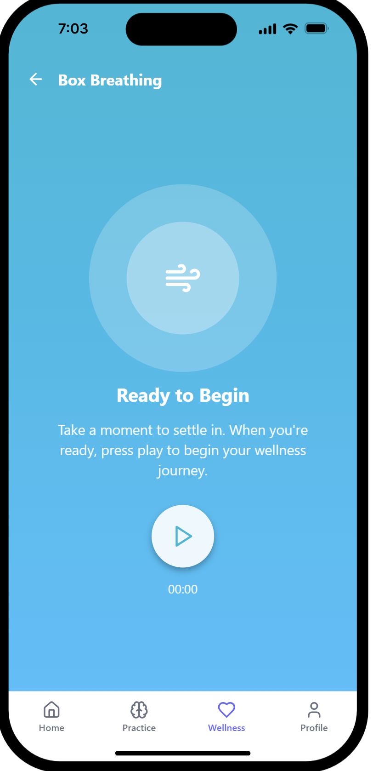
How does different pages work? (Breathing Exercise)

Slide 25
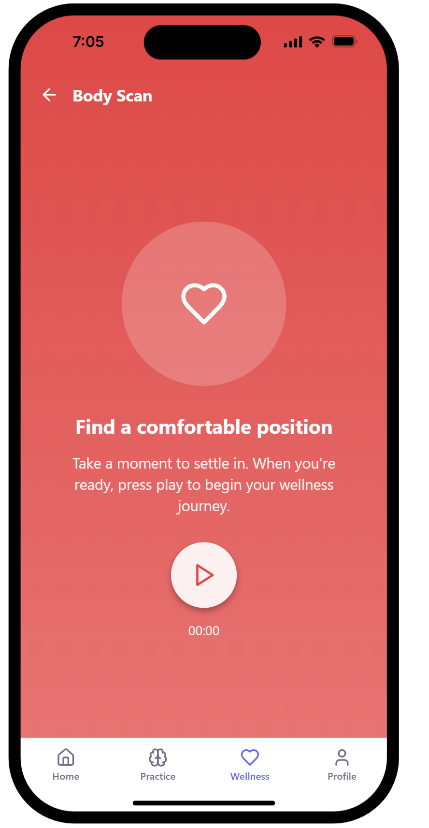
How does different pages work? (Breathing Exercise)

Slide 26
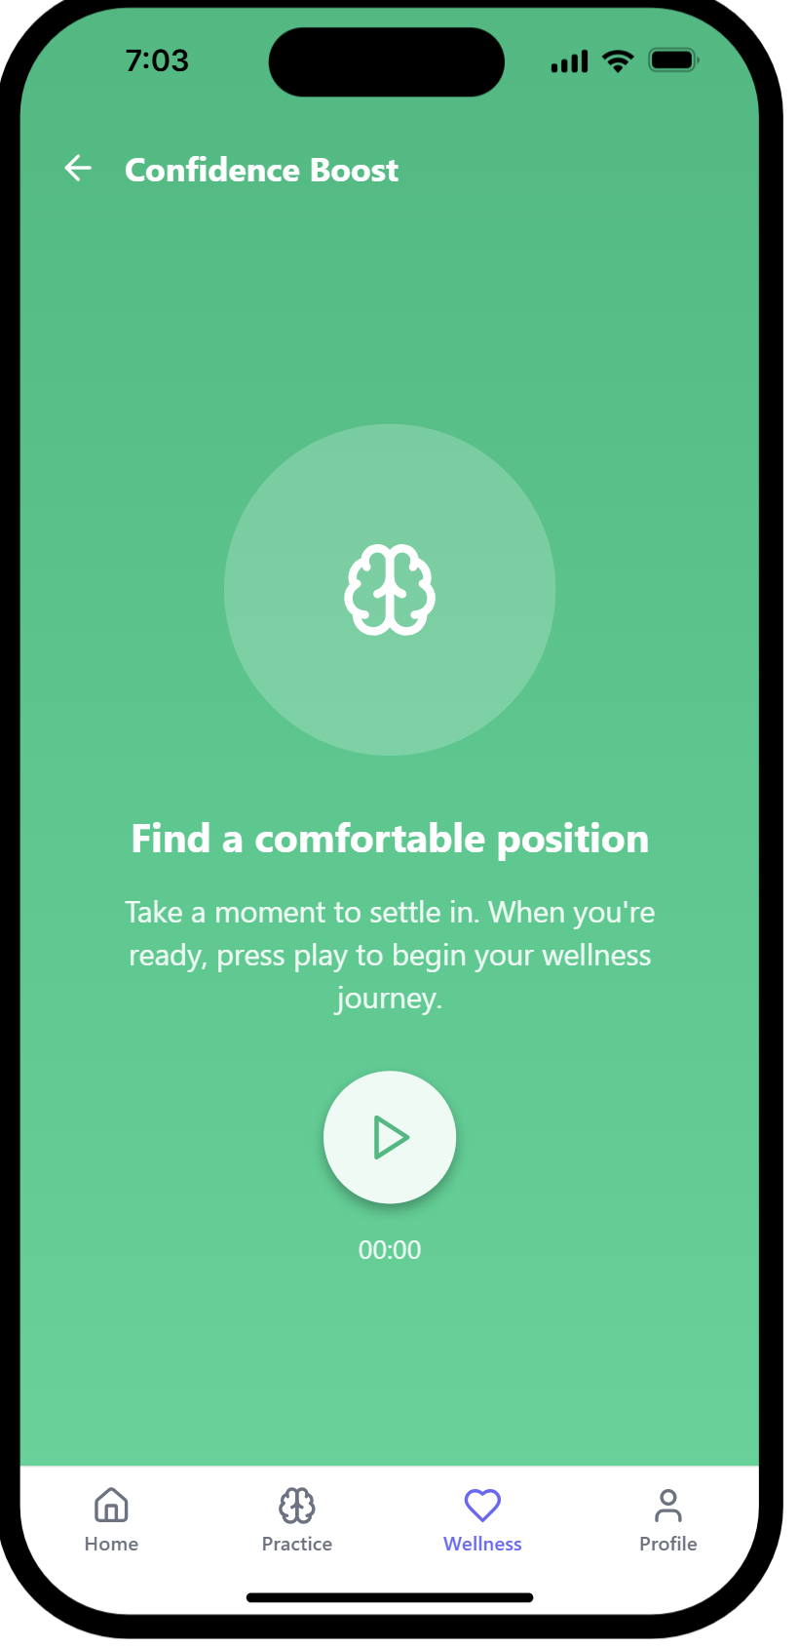
How does different pages work? (Breathing Exercise)

Slide 27
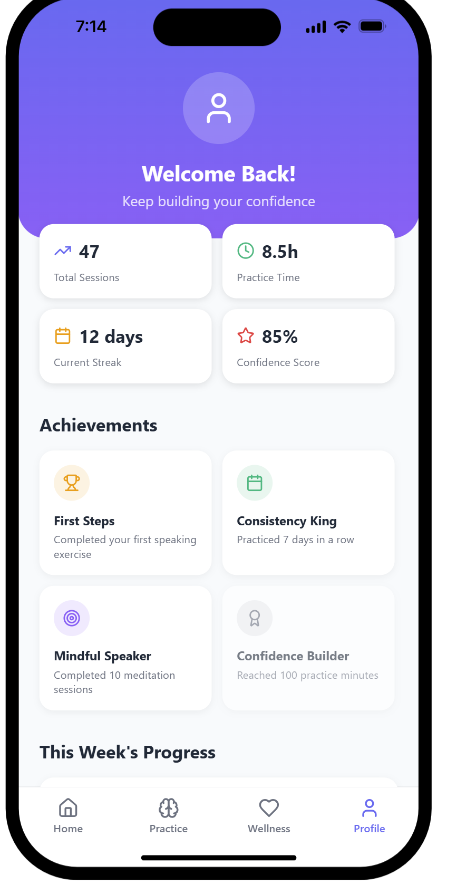
This is how the profile page would look like

Slide 28

Testing table:
Type | What is tested?
Informal(alpha) | Recording yourself with an audio and using app features to analyse the performance
User acceptance(beta) | Ease of use, security and privacy, and engaging features that give higher acceptance
Component | Using an AI recorder to help you speak for communication,practise or improvement
Integration | Engaging lessons and AI-powered practise
System | A creative platform development with specific features
Installation | Searching the app’s name, tap “Install” and open the app
Compatibility | Knowing your device meets the requirement before downloading the app
Usability | Translating the text, customizing the features, and giving more accessible options
Accessibility | Enhancing the language and grammar skills, and improve independence for users
-

Slide 29

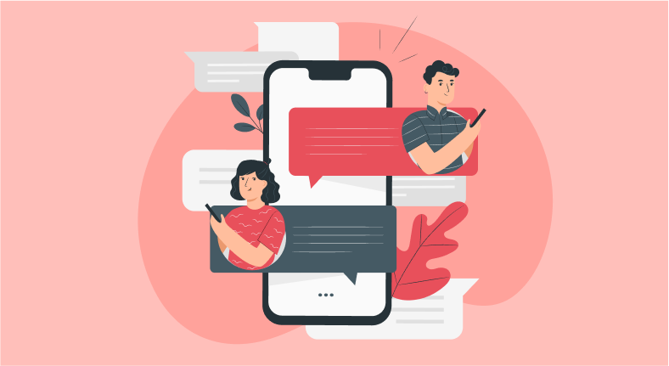
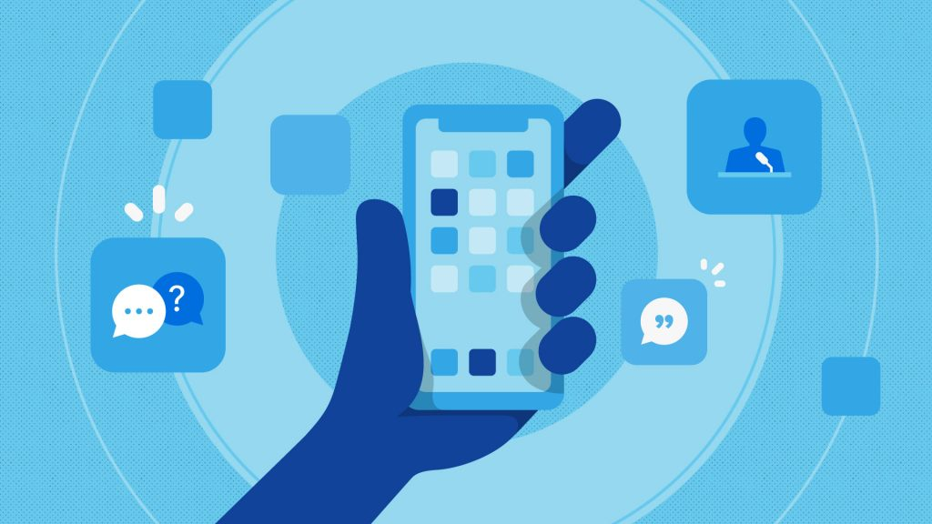
What will be in the project
There will be plenty of options to help your communication in this app
There will be many useful prompts, given the certain circumstances
This app can be used offline

Slide 30

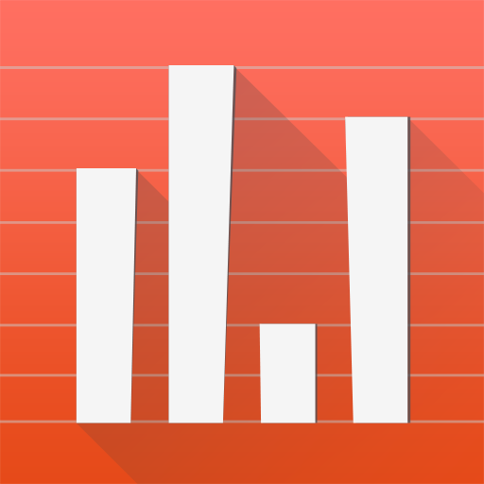
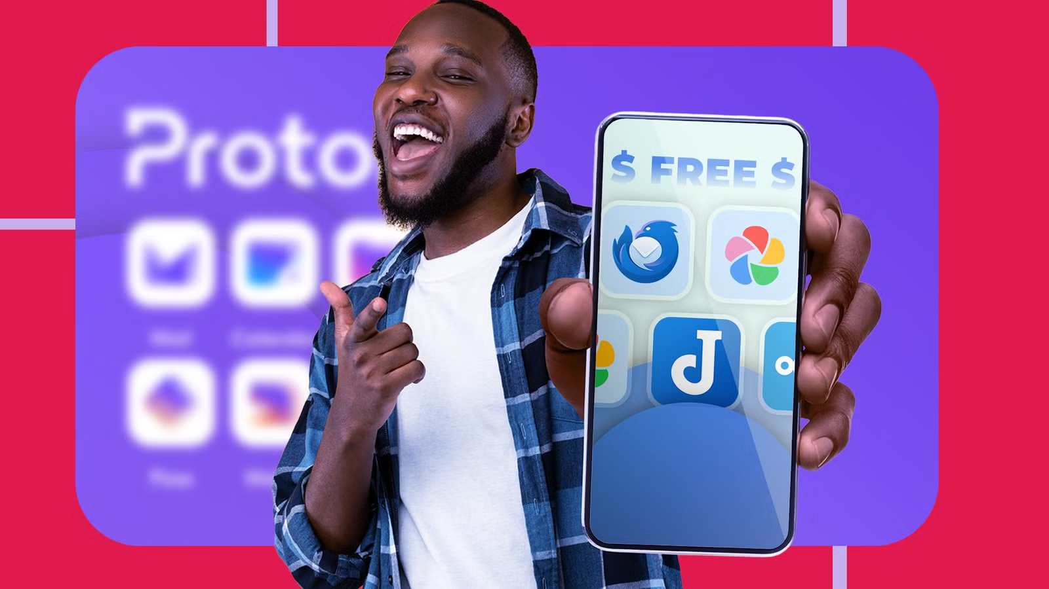
What will not be in the project:
There will be no prices nor subscriptions in our app
It won’t ignore people’s diversity
It wont give you incorrect information

Slide 31
Problem faced:
At first the app was going to built on thonny but after making the code (with help of ai) we didn't really the design so looked alternatives and we came across with “anything” the ai app builder and the design there was much better than in thonny. Which in result is why we have “anything” to make a our final prototype instead of thonny.
The communication could be better at the start, as in the start we would only communicate in class and not outside of class. But in the later stages we did started to communicate outside of school for this project.
We spent too much time on different things, for example we spent too much time on the planning and researching stage mainly because didn't really communicate at the start.
Even with these problems, we think that the presentation and our presentation went fine and smoothly. With fixing the problems that was mentioned above, the project and presentation could have been better

Slide 32
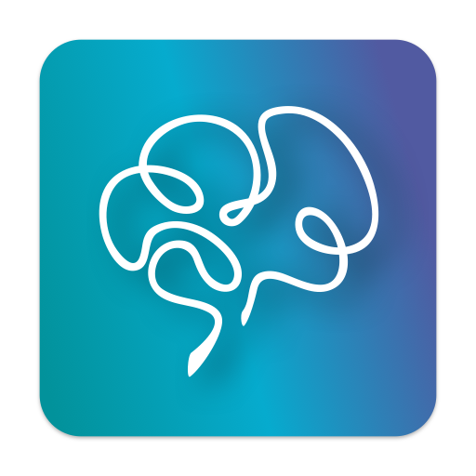
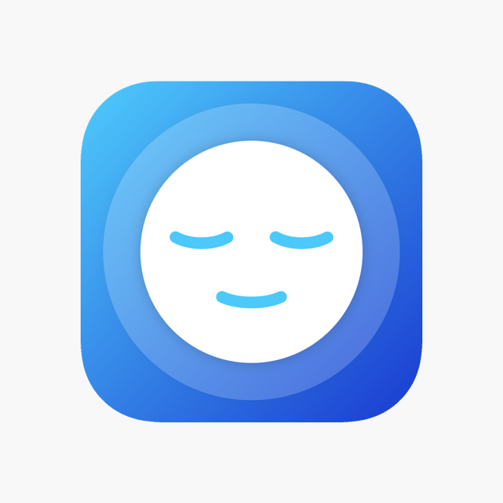
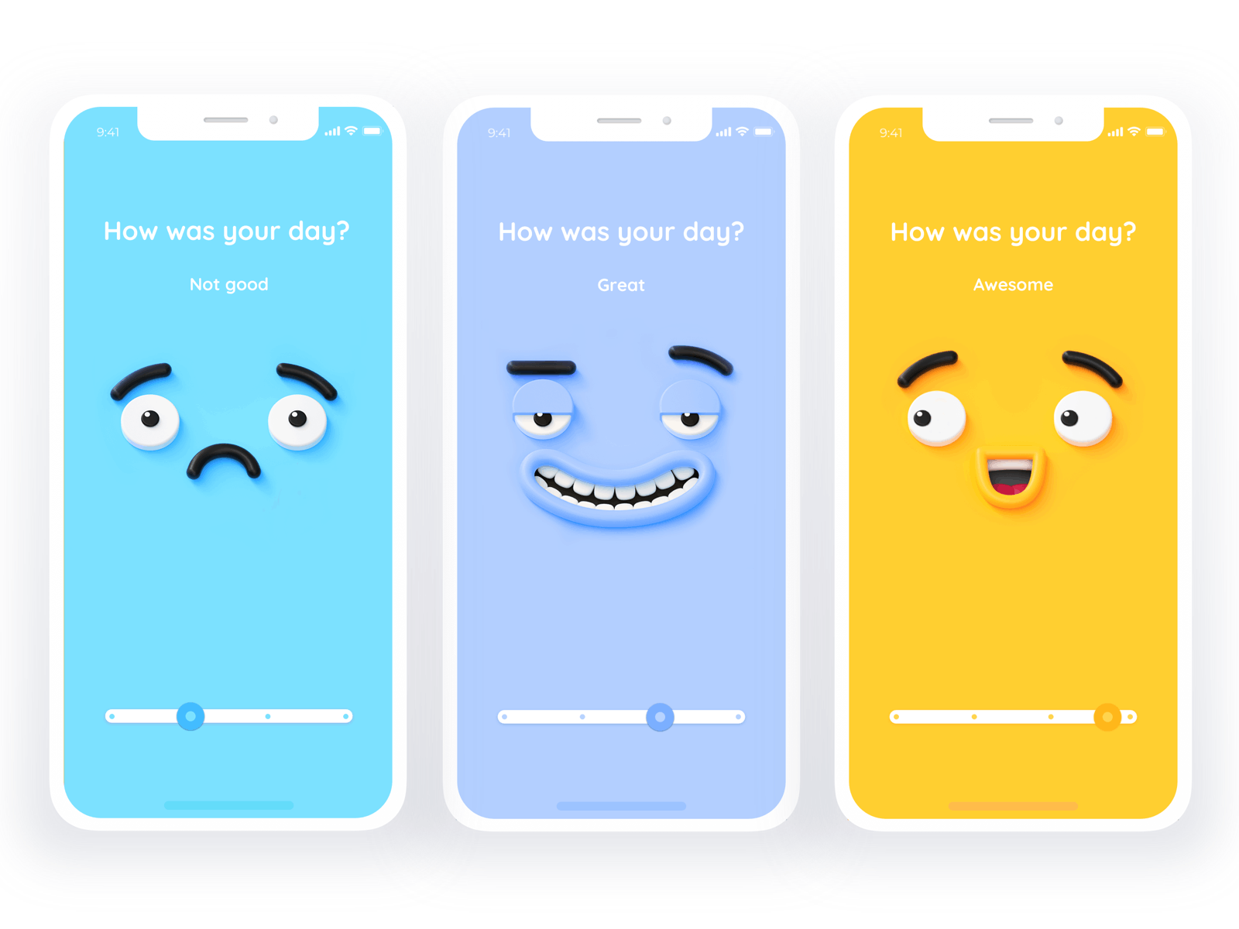
Conclusion:
In conclusion, mindspeak is an app that is designed to help young people to grow their communication skills, as being a good communicator in this day and age will make you stand out, there is a lot of demand but not a lot of supply of this. MindSpeak will help you guys to take your communication skills to the next level.

Slide 33

Resources:
[Materials, software, hardware]
Hardware:
Devices (laptop, phone, iPad)
Google
Microphone
Internet connection
Software
ChatGPT
Youtube
Materials
https://www.smilingmind.com.au/smiling-mind-app
https://www.headspace.com/content/mindful-activity/commuting/109
https://www.mindful.org/free-mindfulness-apps-worthy-of-your-attention/
https://shoorah.io/mindfulness-on-the-move-how-our-app-fits-into-your-busy-lifestyle/
used “Anything” to make the prototype. Its an Ai app builder

Slide 34
Thanks for listening!

